Slide 1
Understanding Diabetes with Data Science
Ayodeji (DJ) Akinbode

Slide 2
Current Issue with Diabetes
Increase in Number (10.5% of the US population)
Cost $622 billion by 2030
Comorbidities and Complication

Slide 3
Data Source
NHANES (National Health and Nutrition Examination Survey)
Background
Data Type (Demographic, Physical exams, Laboratory and Questionnaires)
Unique Identifier ((SEQN).

Slide 4
Statistical Analysis
Measurement Scaling
Linear Regression
Testing P values
Programing Language (Python)

Slide 5
Python Libraries
Pandas
Numpy
Scipy
Itertools (groupby)
Matplotlib
Seaborn
Statsmodels

Slide 6
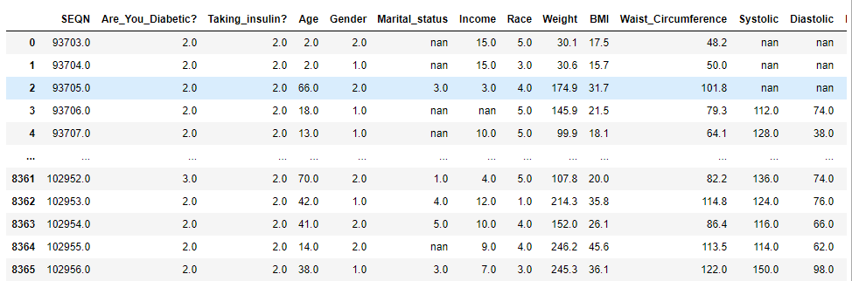
Extracted and Processed Data
Data Sample (8366 rows × 15 columns)

Slide 7
Variables
SEQN Weight Race
Are_You_Diabetic? BMI Precription_Plan
Taking_insulin? Waist_Circumference Health_Coverage
Age Systolic Income
Gender Diastolic Marital_status

Slide 8
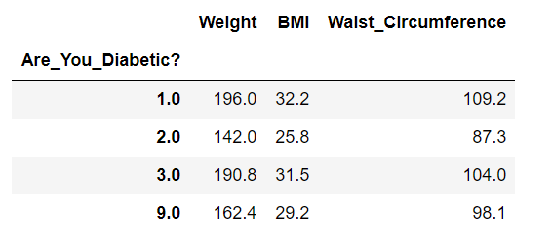
Statistical Analysis (Results)
Measurement Scaling
# 1= Diabetic
# 2= Nondiabetic
# 3= Borderline diabetic
# 9= Don't know

Slide 9
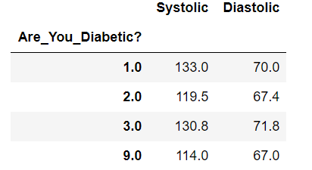
Measurement Scaling (cont)
Diabetics and Cardiovascular Health
# 1= Diabetic
# 2= Nondiabetic
# 3= Borderline diabetic
# 9= Don't know

Slide 10
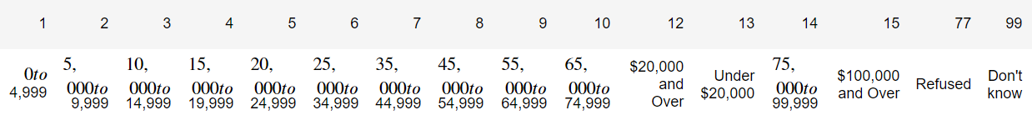
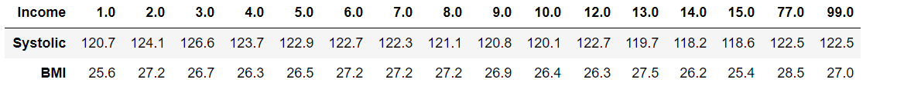
Measurement Scaling (cont) Income

Slide 11
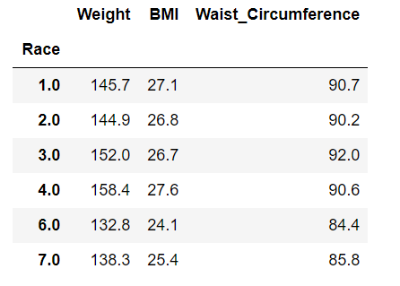
Measurement Scaling (cont) Race
# 1= Mexican American
# 2= Other Hispanic
# 3= White American
# 4= Black American
# 6= Asian American
# 7= Other Race - Including Multi-Racial

Slide 12
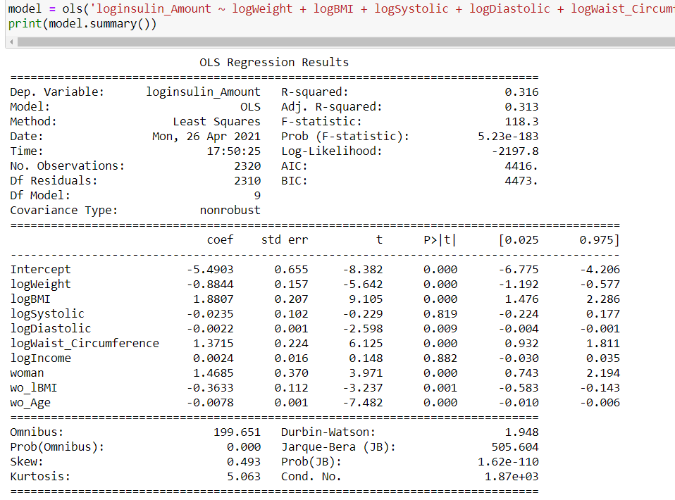
Linear Regression (OLS Regression)
Insulin Amount= Dependent Variable
Y=bo+b1x1 +b2x2 +E

Slide 13
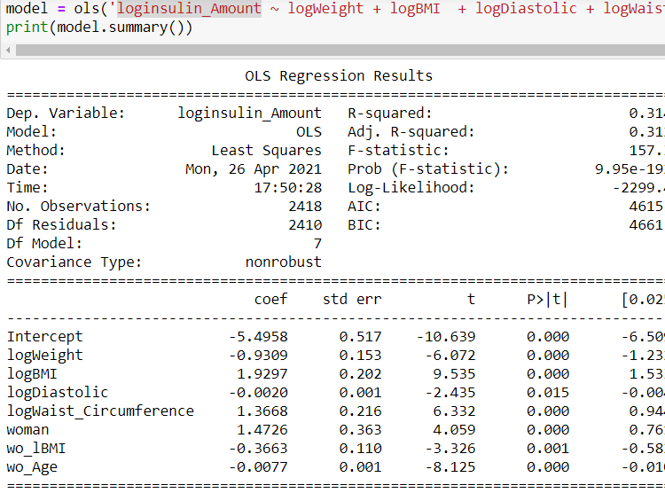
Linear Regression (OLS Regression)
Insulin Amount= Dependent Variable
Y=b0 + b1x1+ b2x2 + E
Age
BMI
Waist Circumference
Weight
Diastolic

